Slide 1
What did you do?
The past

Slide 2
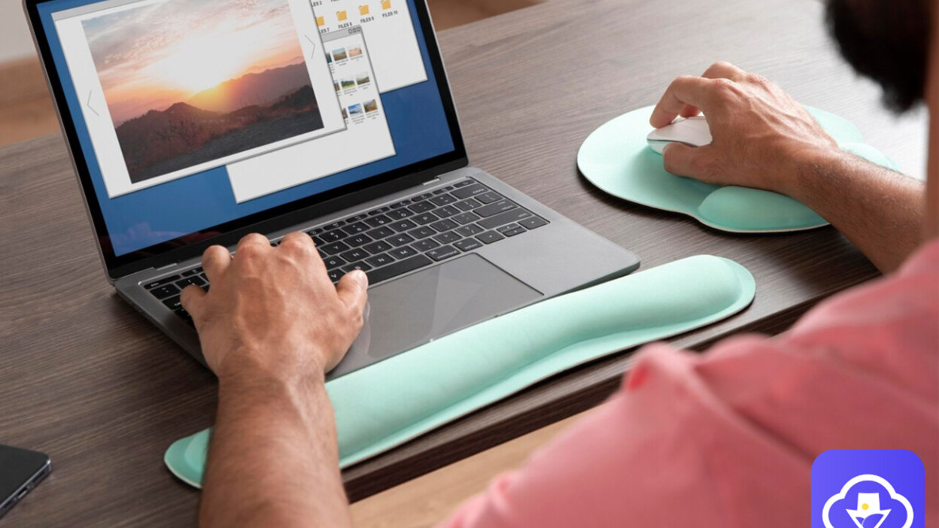
downloaded pictures

Slide 3
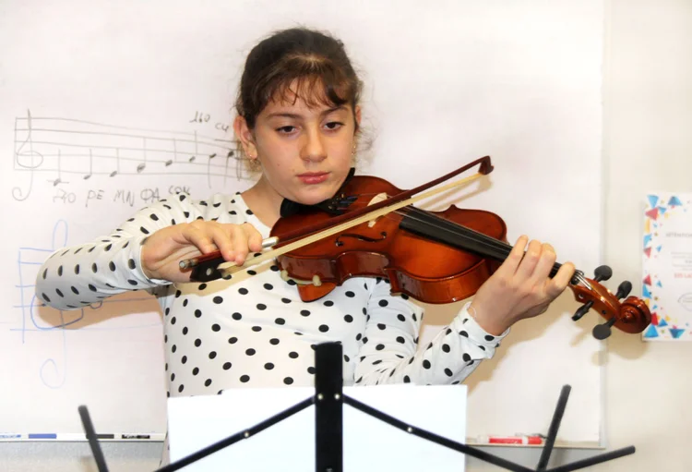
practiced the violin

Slide 4
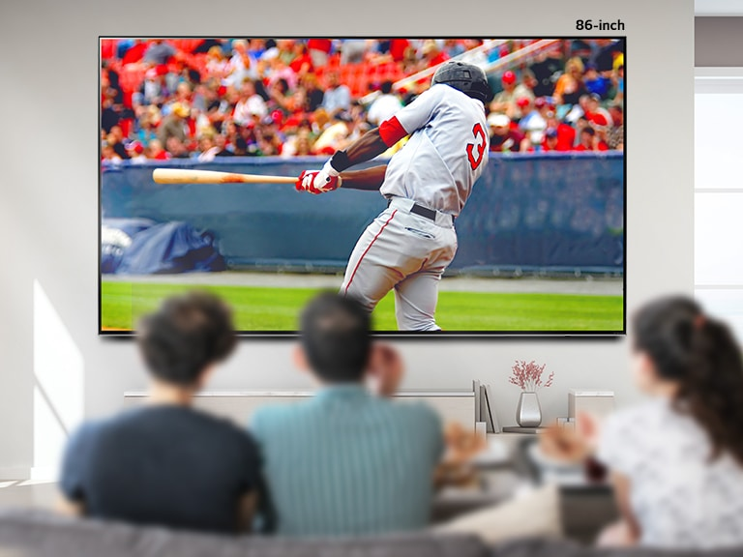
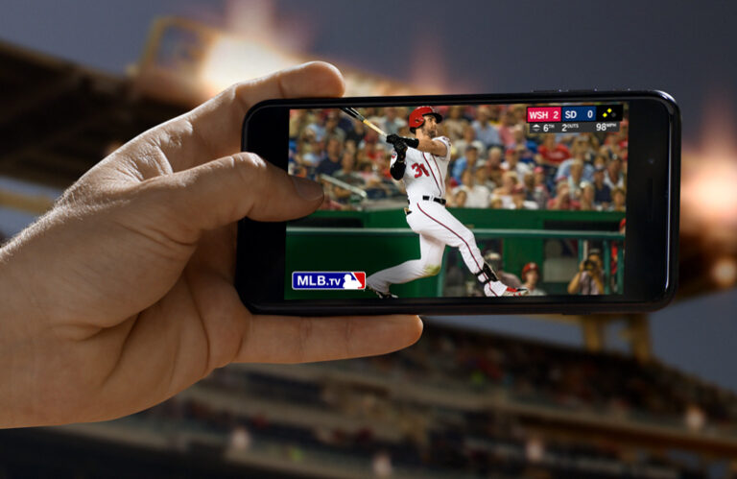
watched a baseball game

Slide 5

listened to music

Slide 6
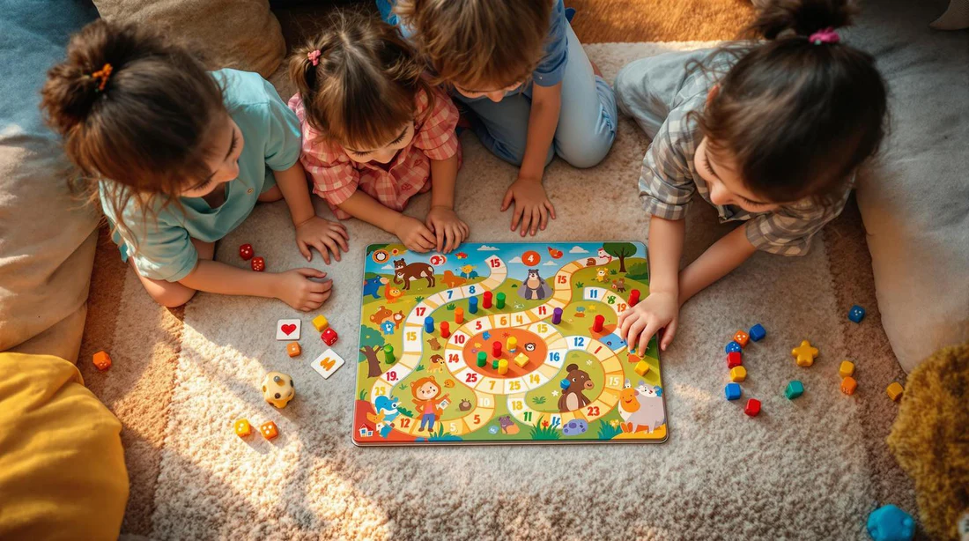
played a board game

Slide 7
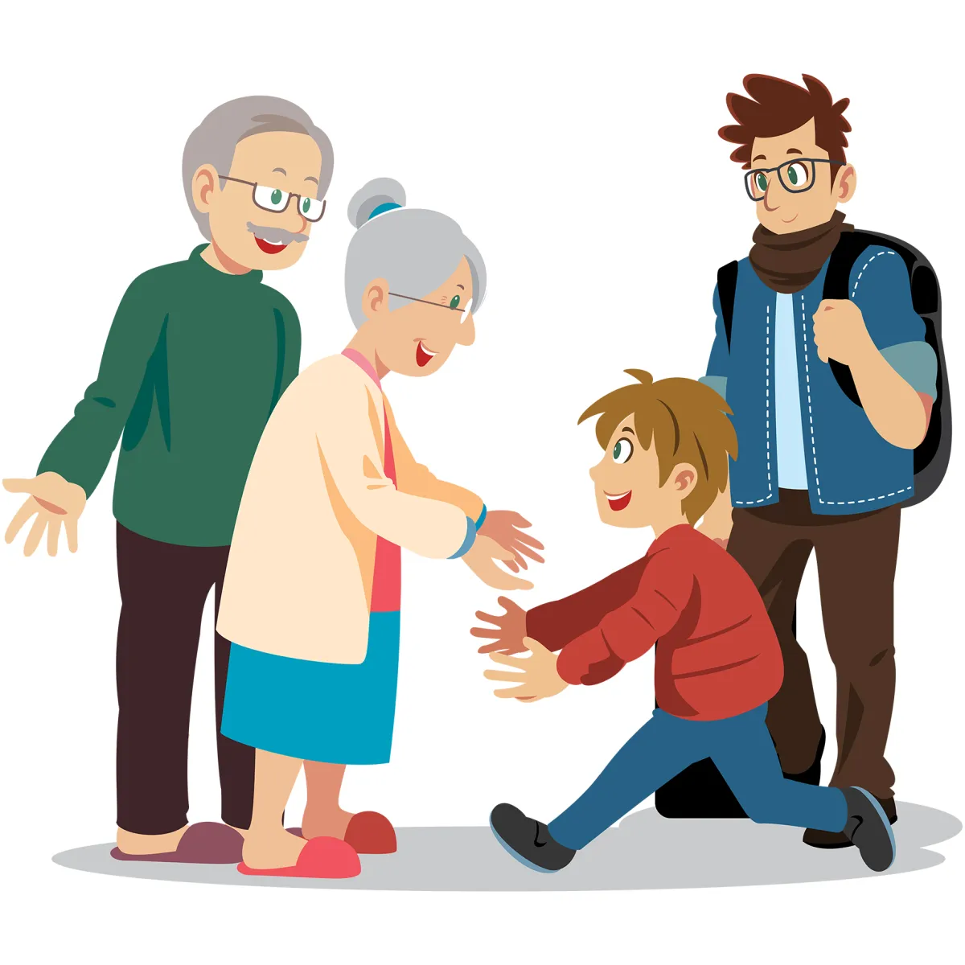
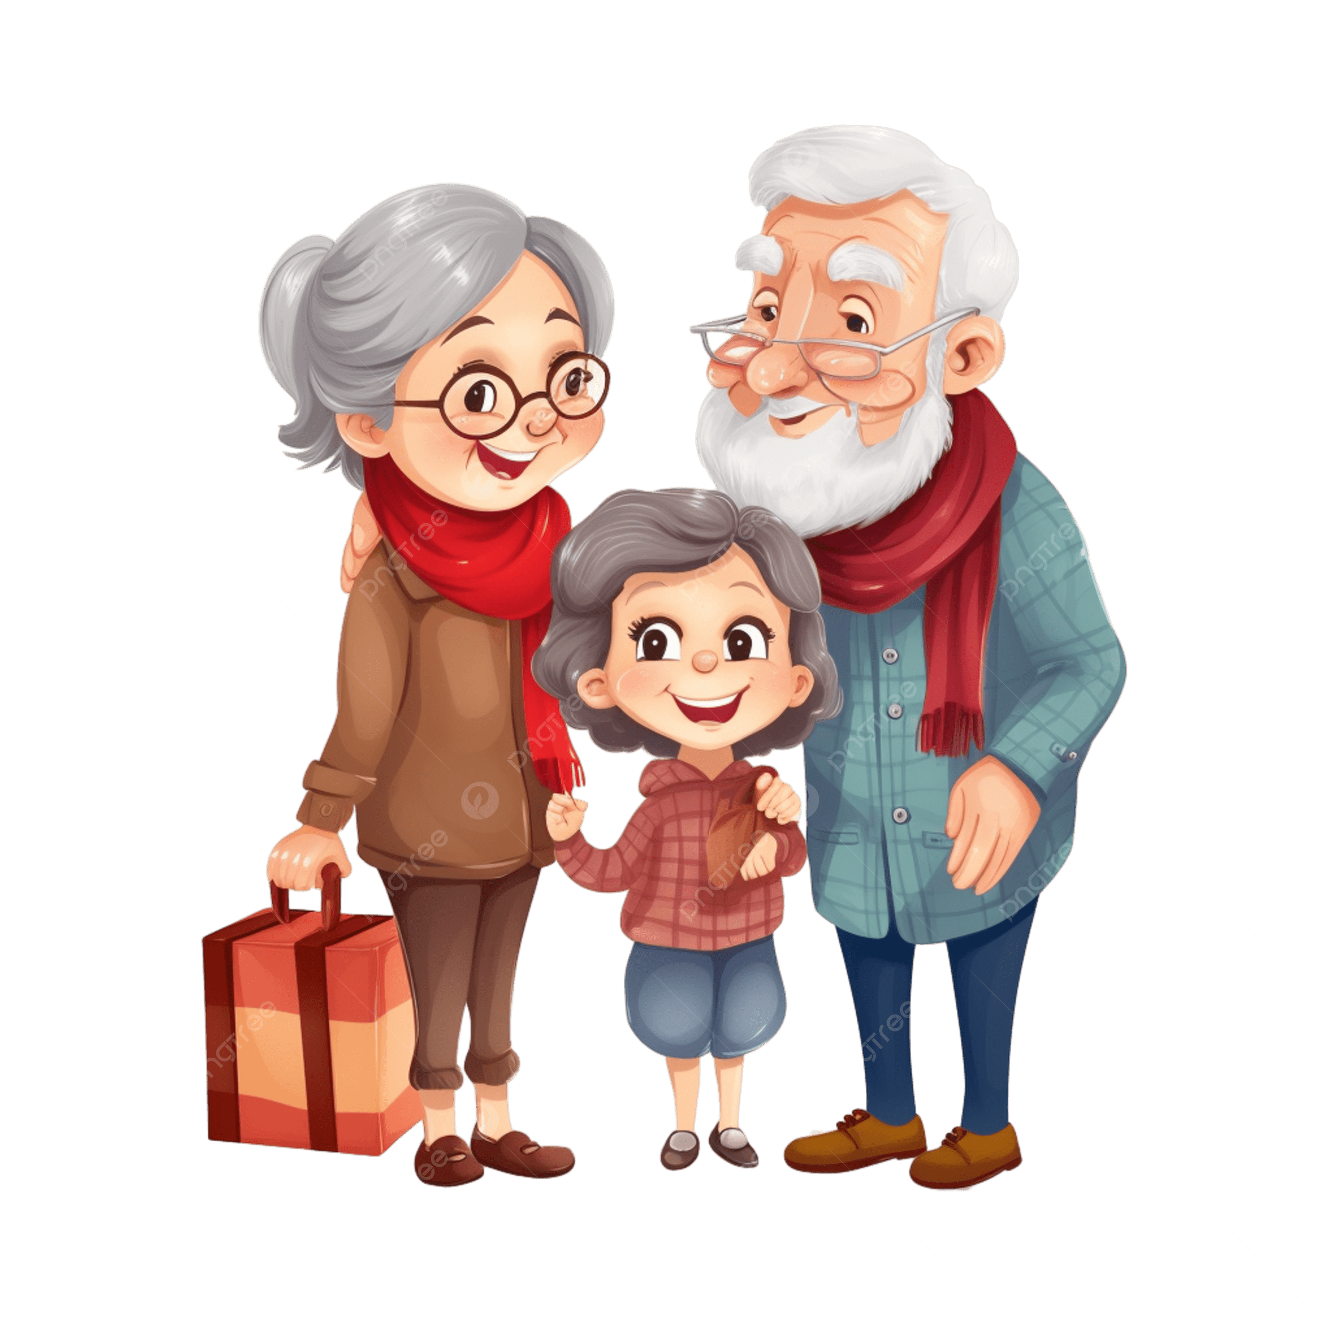
visited my grandparents

Slide 8
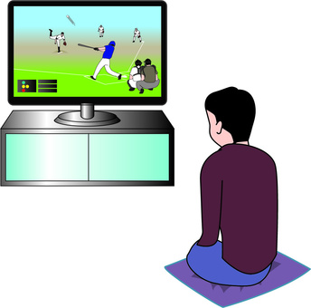
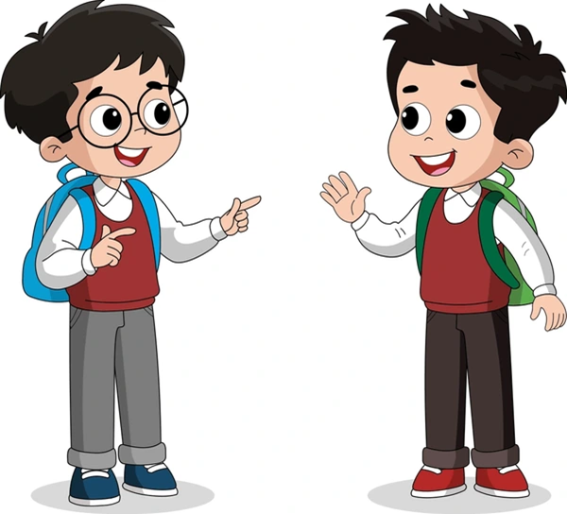
What did you do on Sunday?
I watched a baseball game.

Slide 9
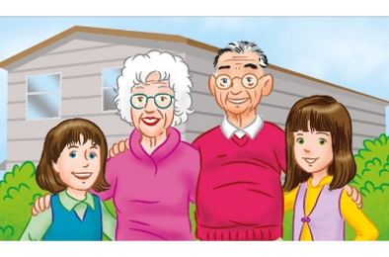
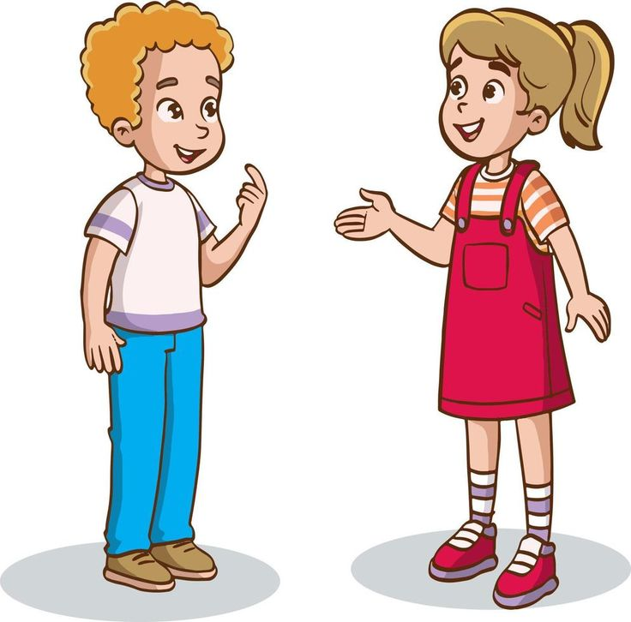
What did you do on Sunday?
I visited my grandparents.

Slide 10
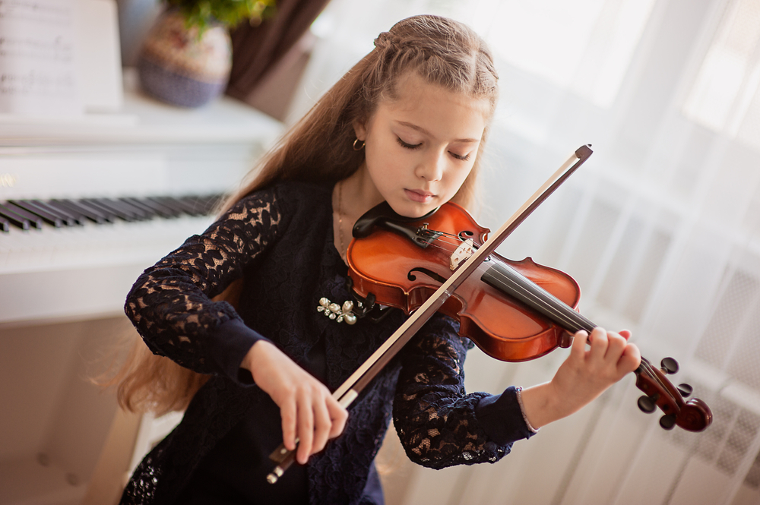
What did you do on Sunday?
I practiced the violin.

Slide 11
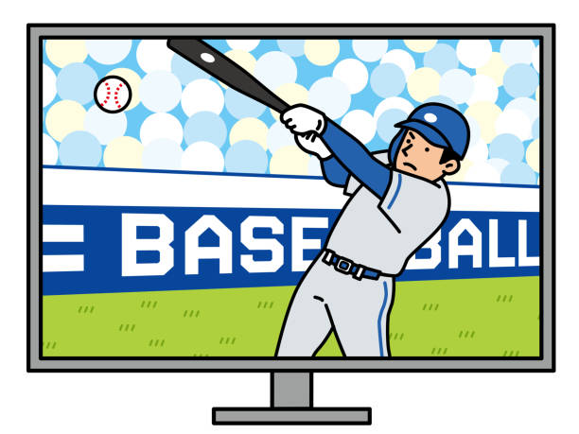
A: What did you do on Sunday?
B: I watched a baseball game.

Slide 12
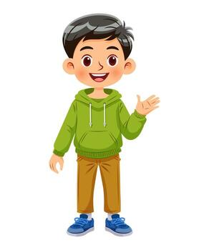
He (boys)

Slide 13

She (girls)

Slide 14
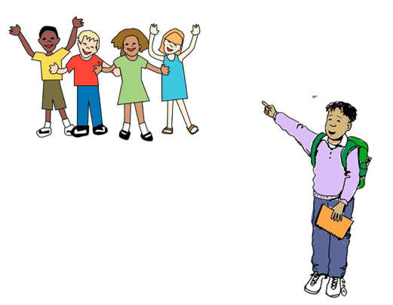
They

Slide 15
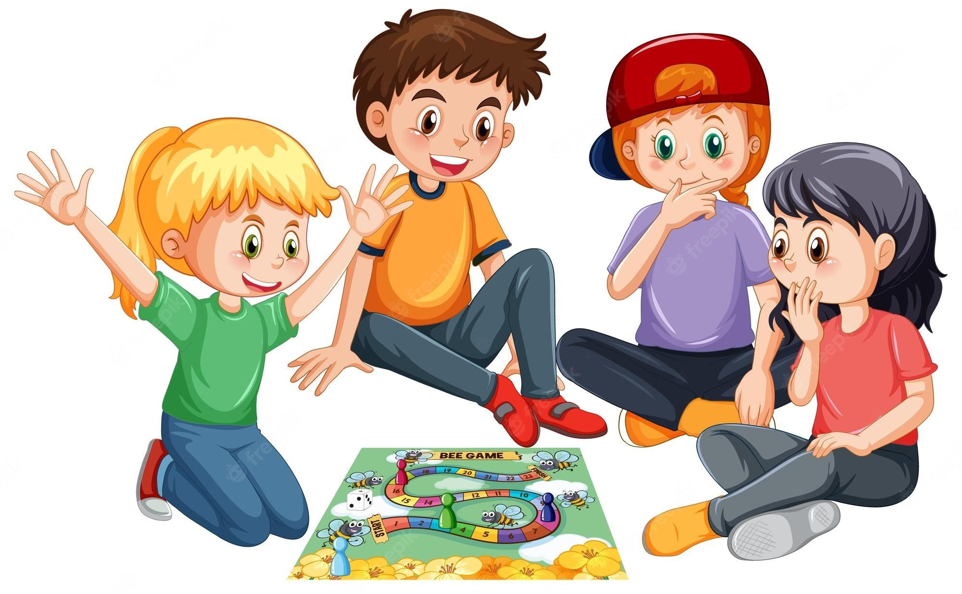
What did they do on Sunday?
They played a board game.

Slide 16

What did she do on Sunday?
She listened to music.

Slide 17

What did he do on Sunday?
He downloaded pictures.

Slide 18

What did you do on Sunday?
I listened to music.

Slide 19
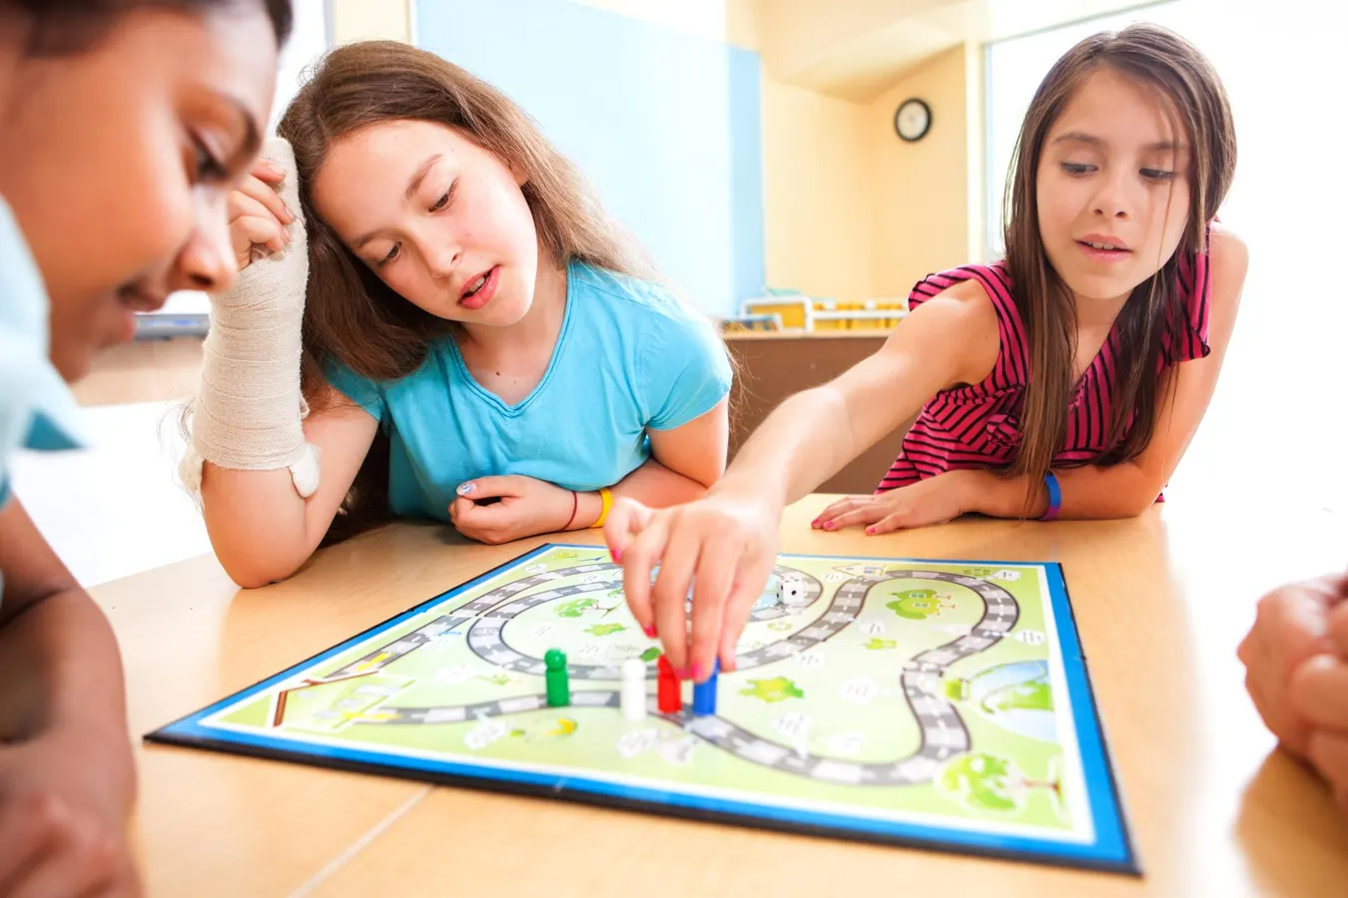
What did you do on Sunday?
I played board games.

Slide 20
What did you do on Sunday?
I downloaded pictures.

Slide 21
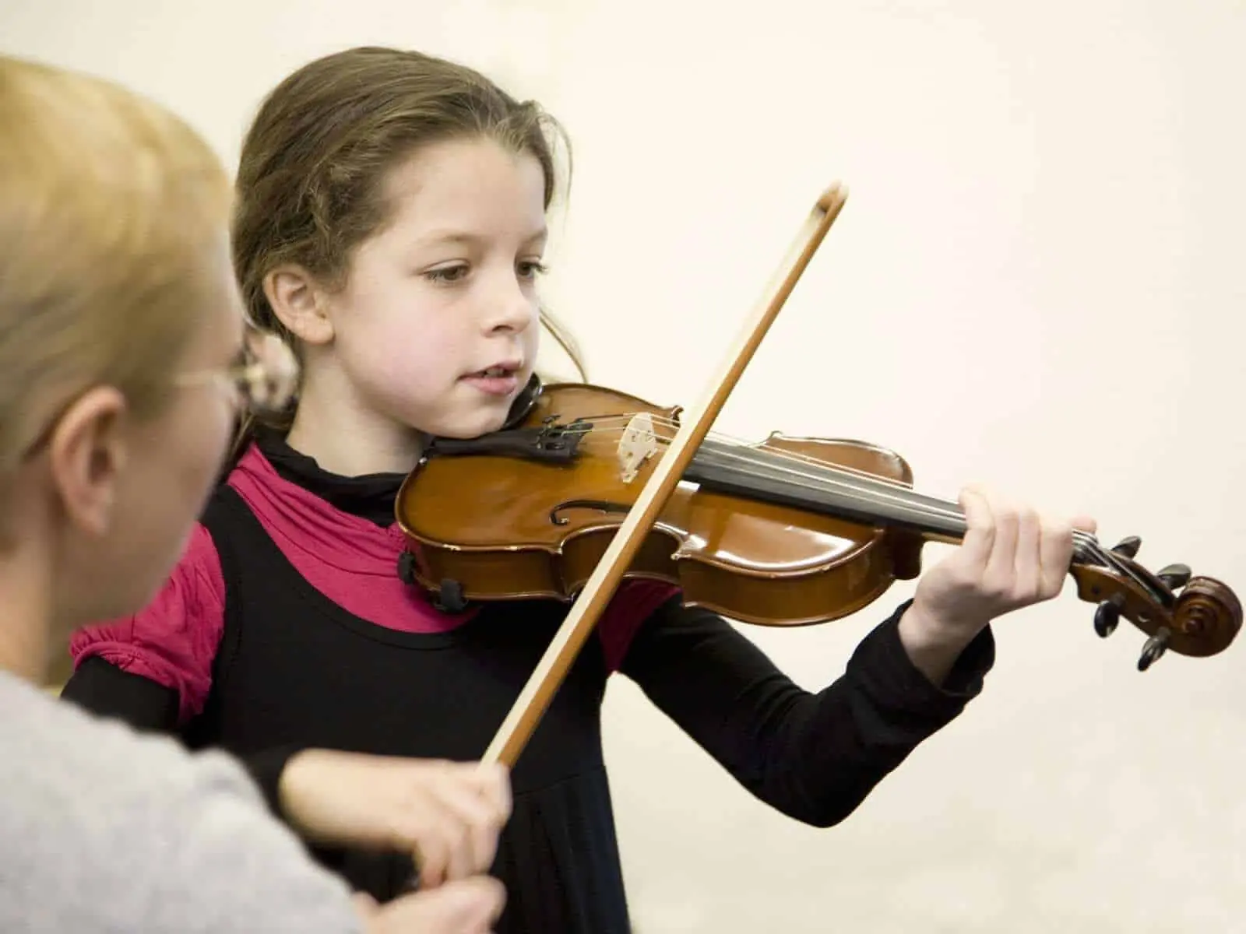
What did you do you on Sunday?
I practiced the violin.

Slide 22
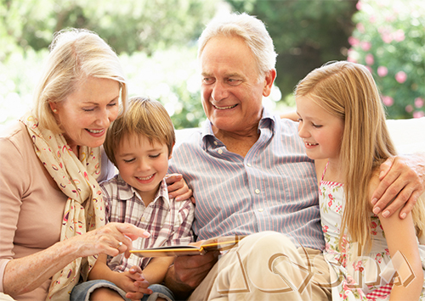
What did you do on Sunday?
I visited my grandparents

Slide 23
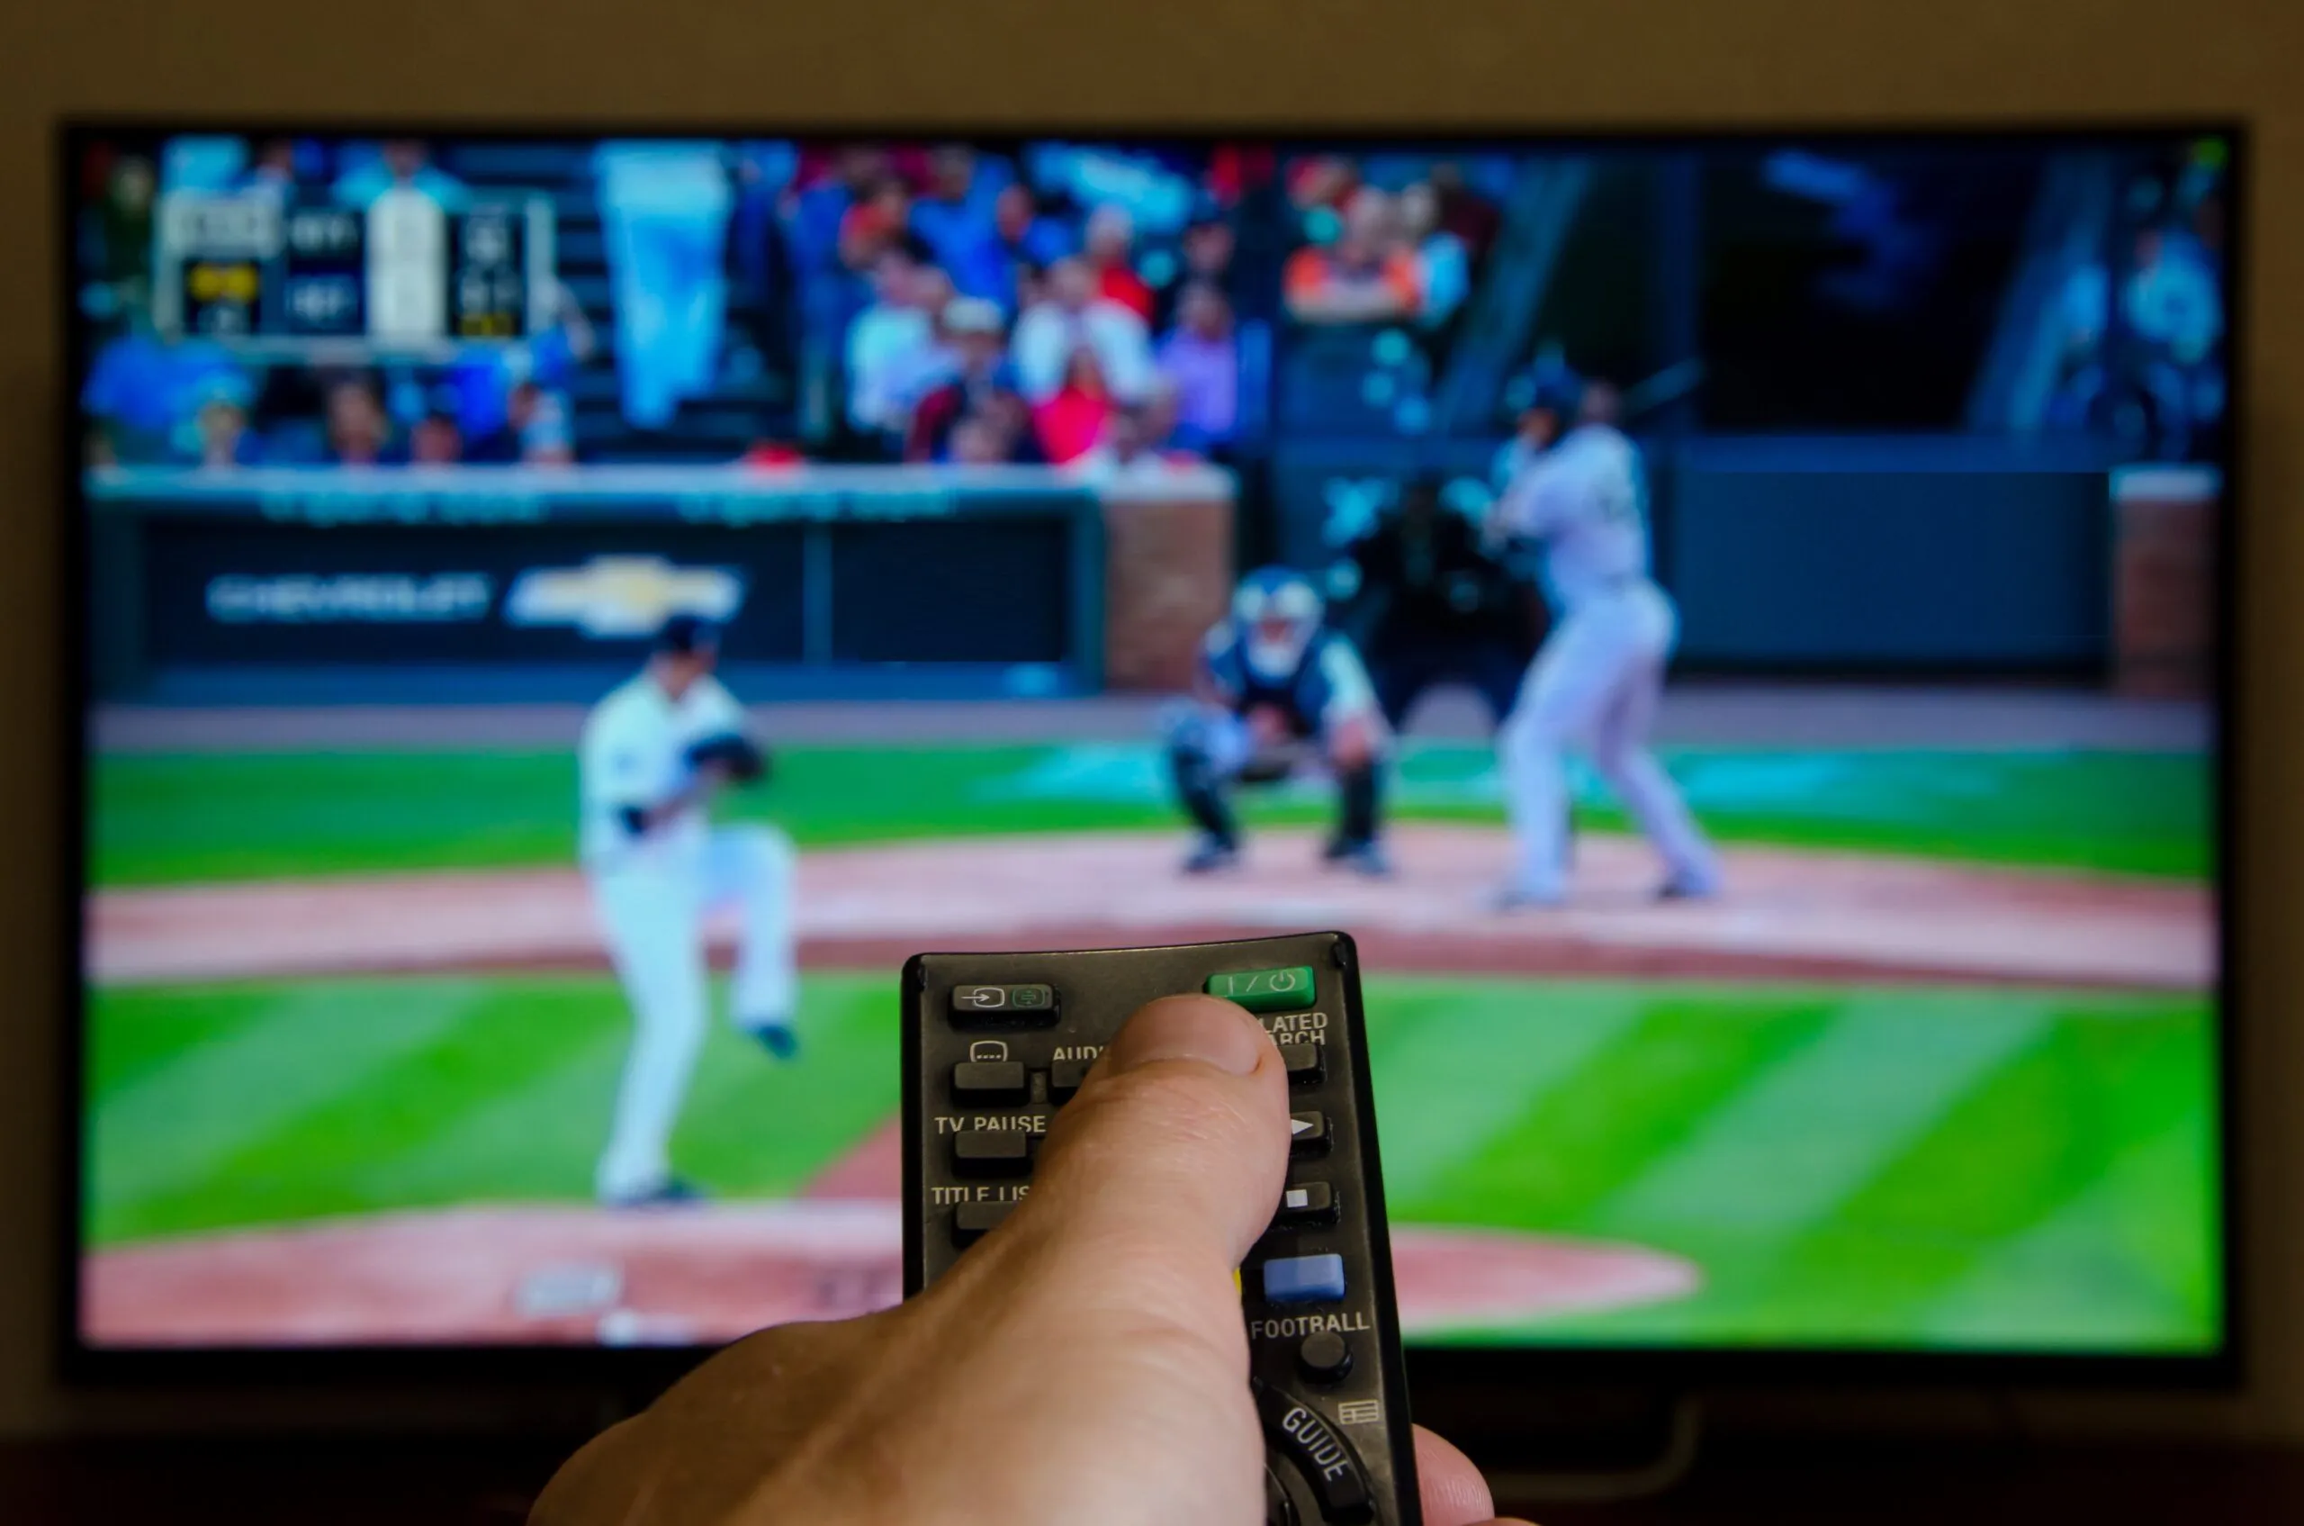
What did you do on Sunday?
I watched a baseball game.

Slide 24
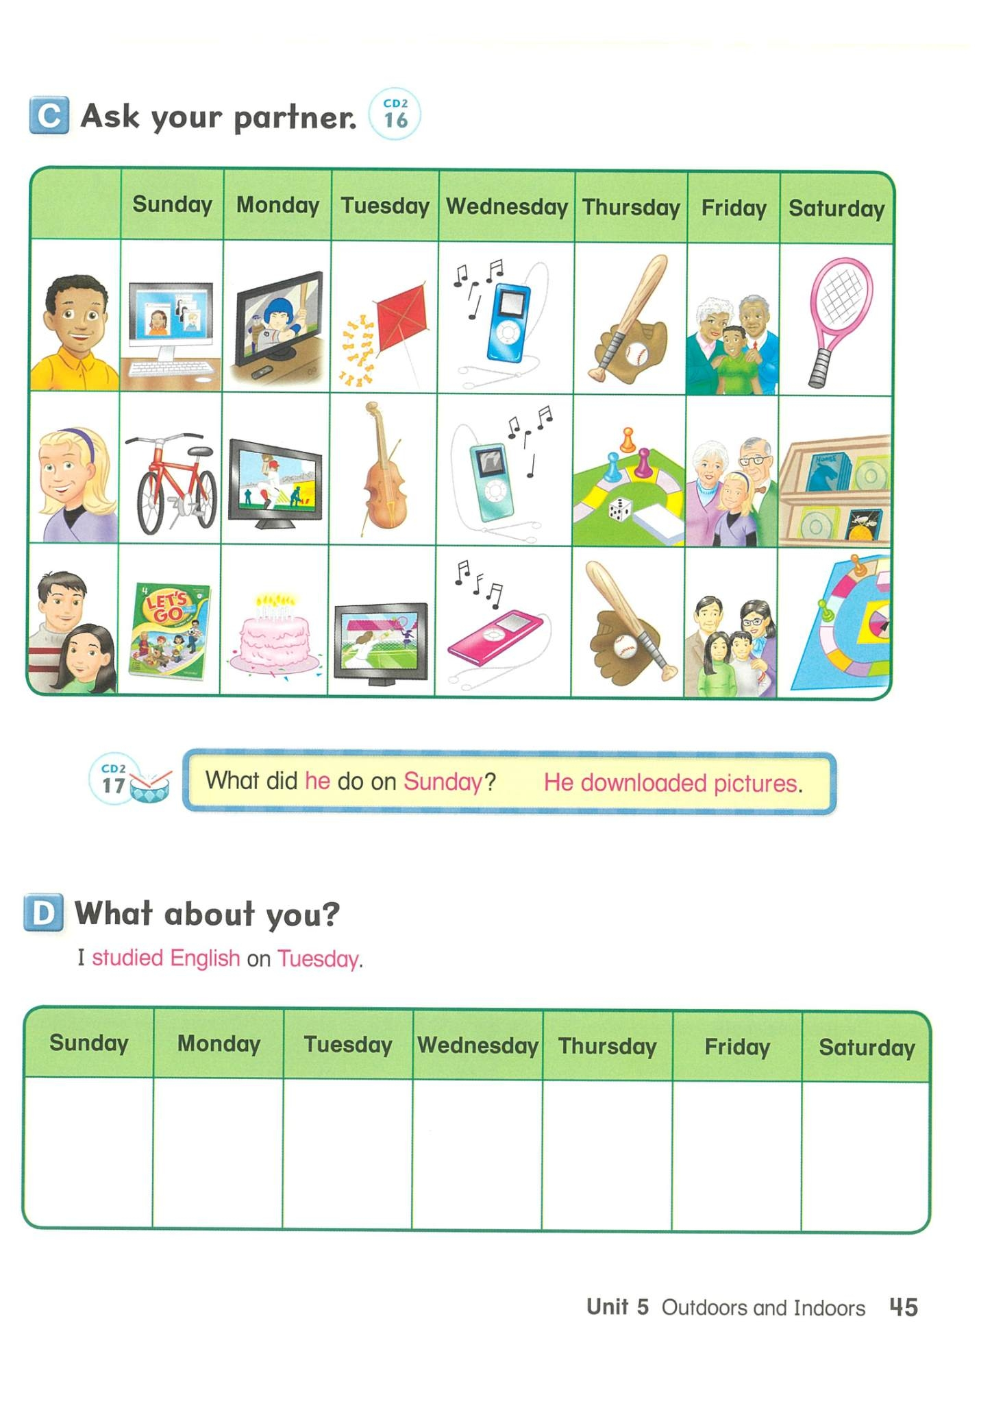

Slide 25
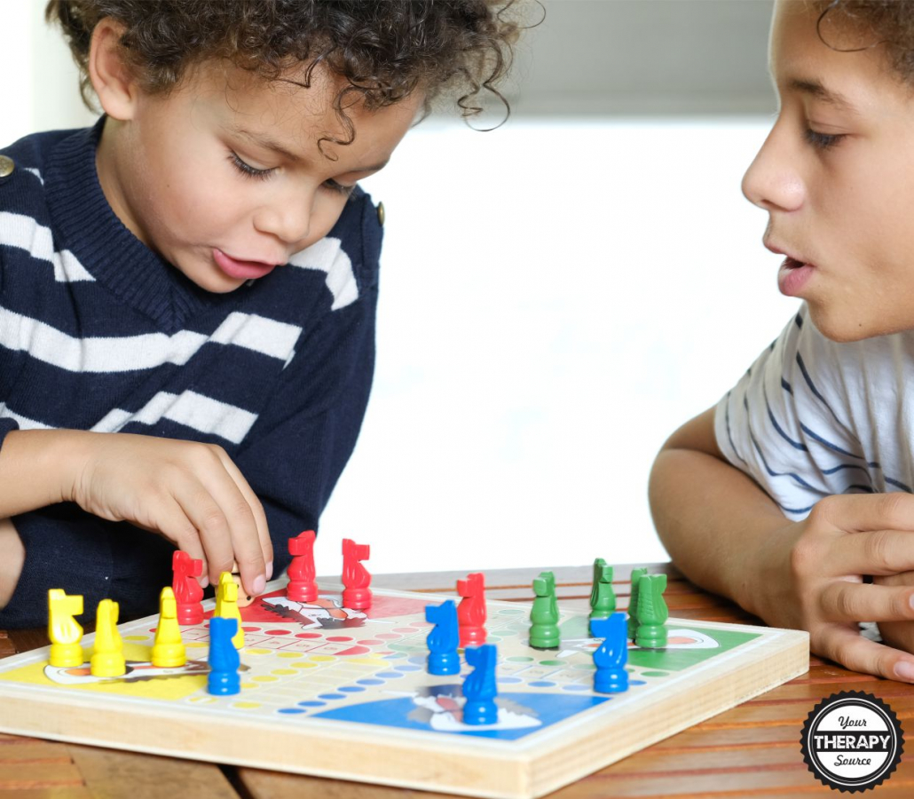
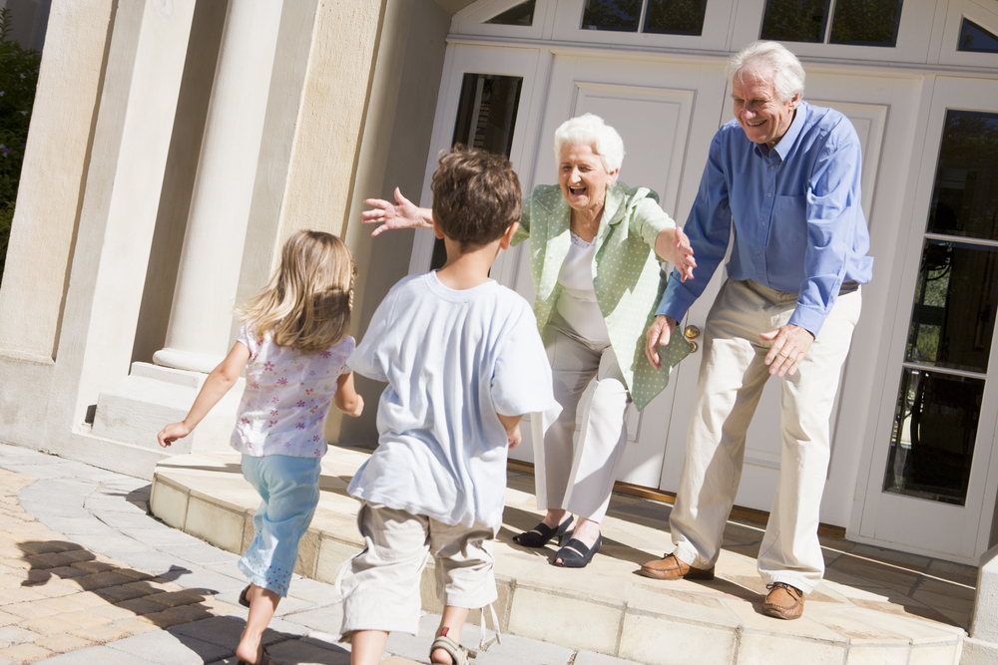

Visited my grandparents
C
A
B

Slide 26
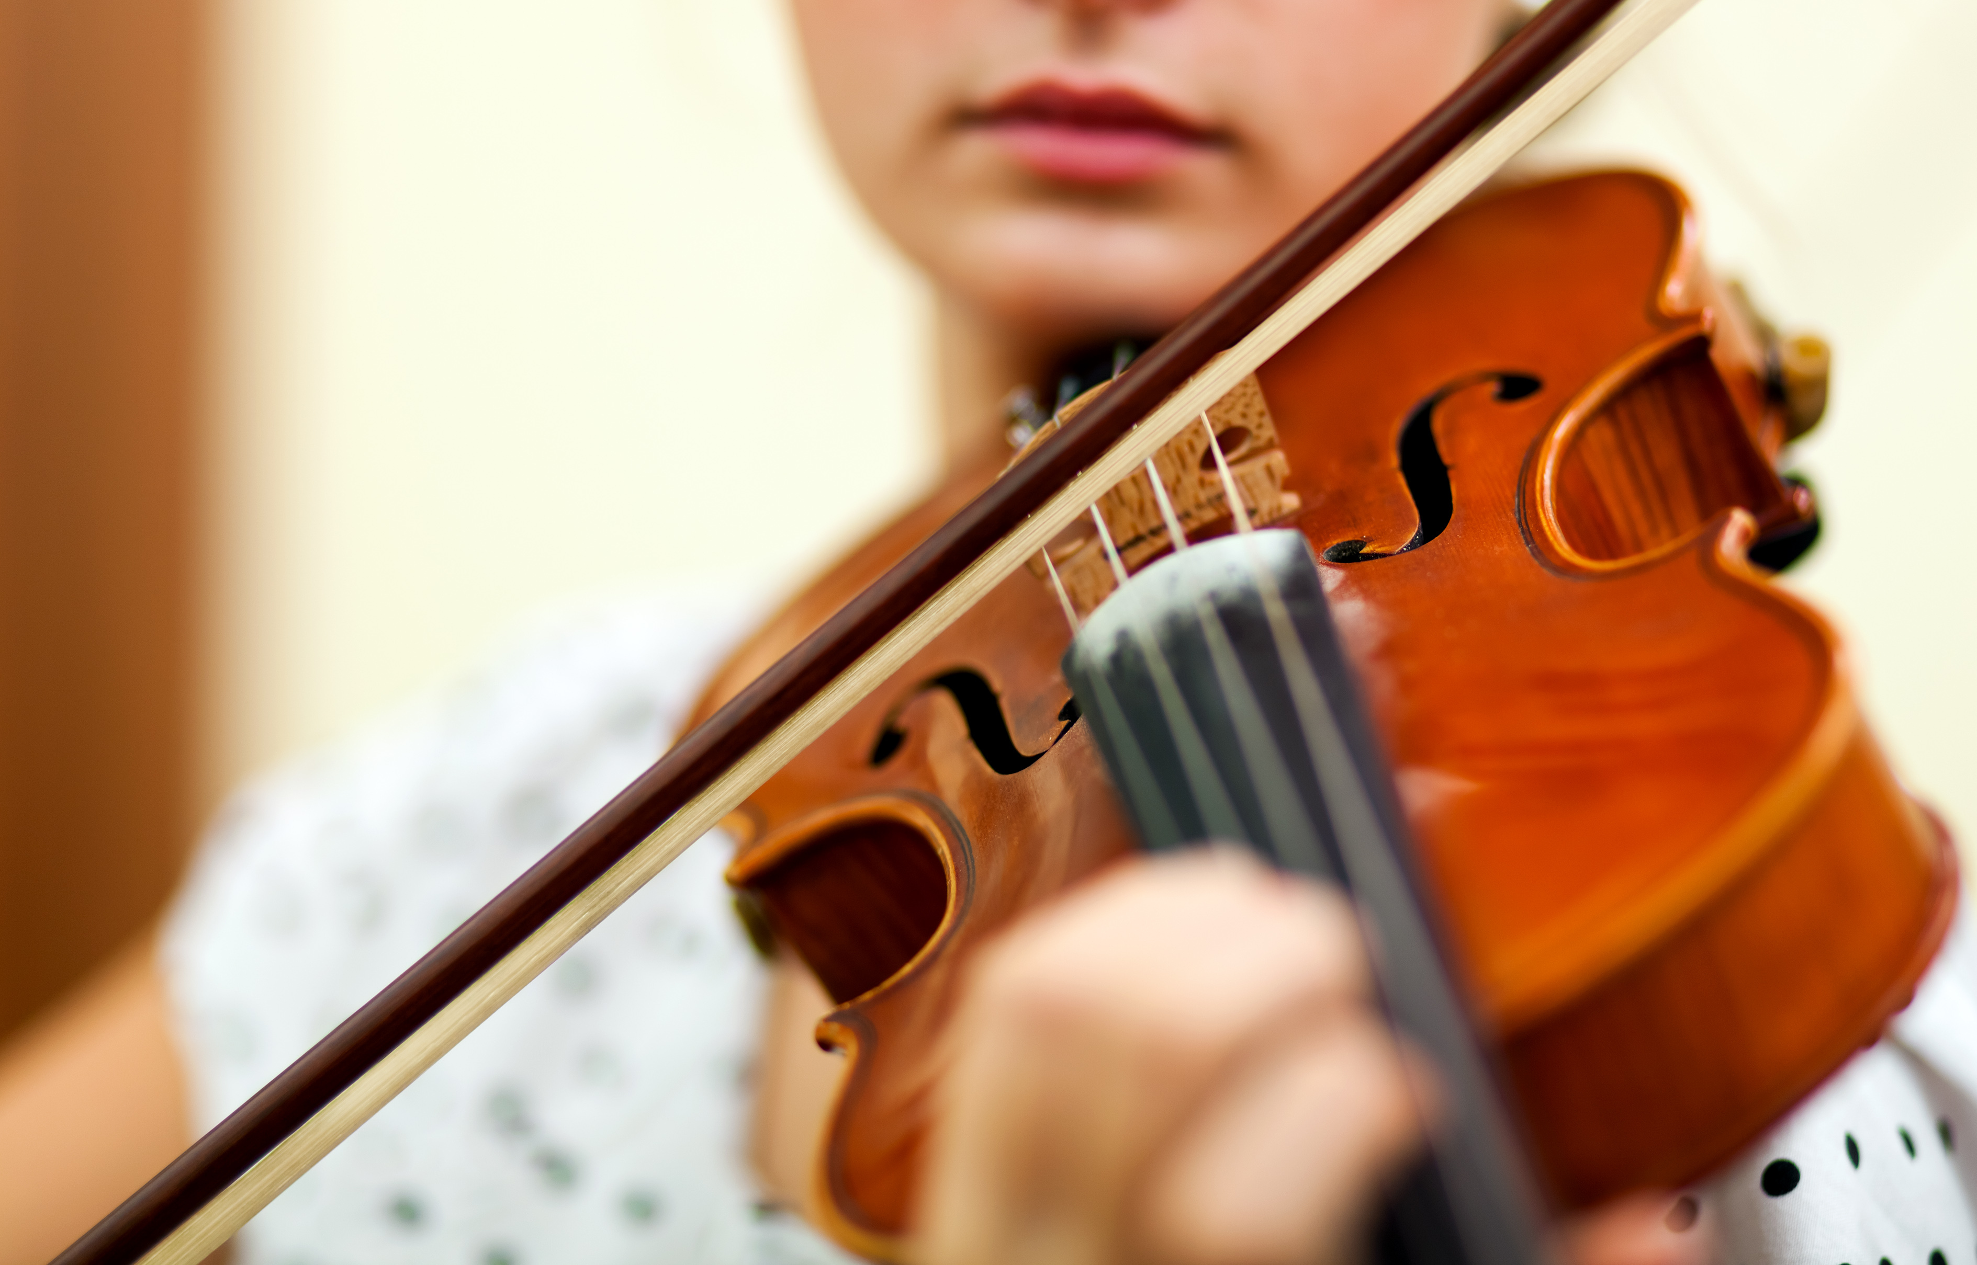
Played a board game
A
B
C

Slide 27

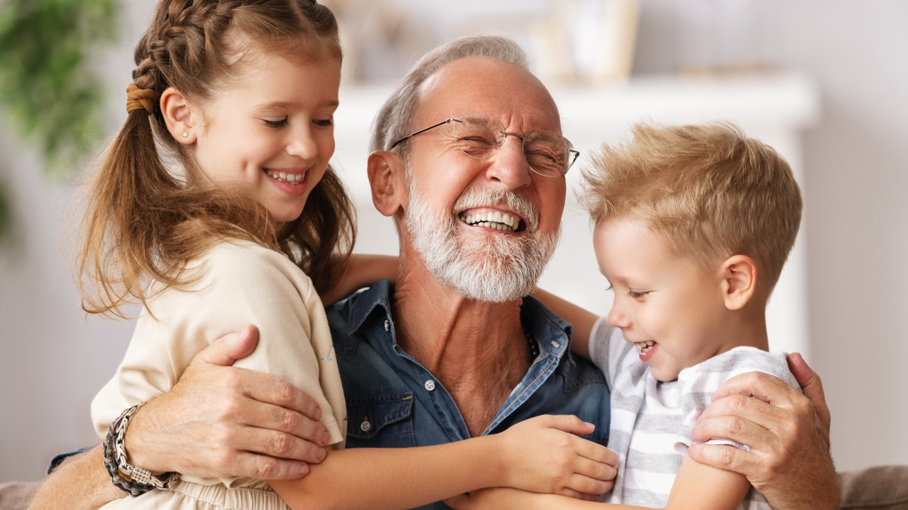
Listened to music
A
B
C

Slide 28
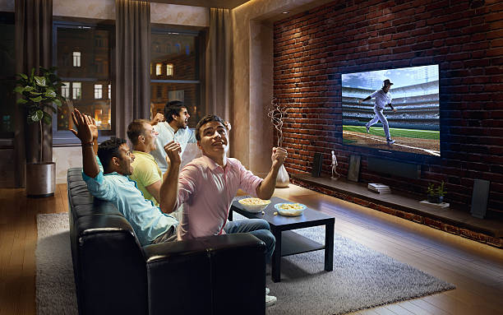
What did you do?
A. Downloaded pictures
B. Visited my grandparents
C. Watched a baseball game

Slide 29
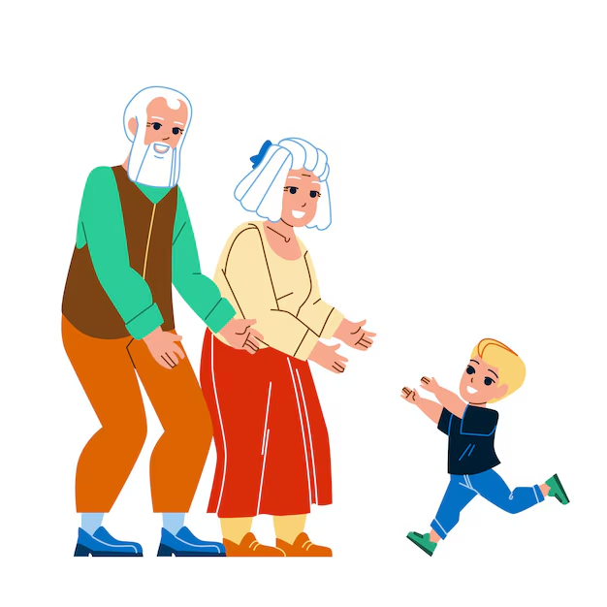
What did he do?
A. Listened to music
B. Visited my grandparents
C. Downloaded pictures

Slide 30
What did you do?
A. Downloaded pictures
B. Listened to music
C. Watched a baseball game

Slide 31
What did you do?
A. Visited my grandparents
B. Watched a baseball game
C. Played a board game

Slide 32

What did you do?
A. Downloaded pictures
B. Listened to music
C. Watched a baseball game

Slide 33
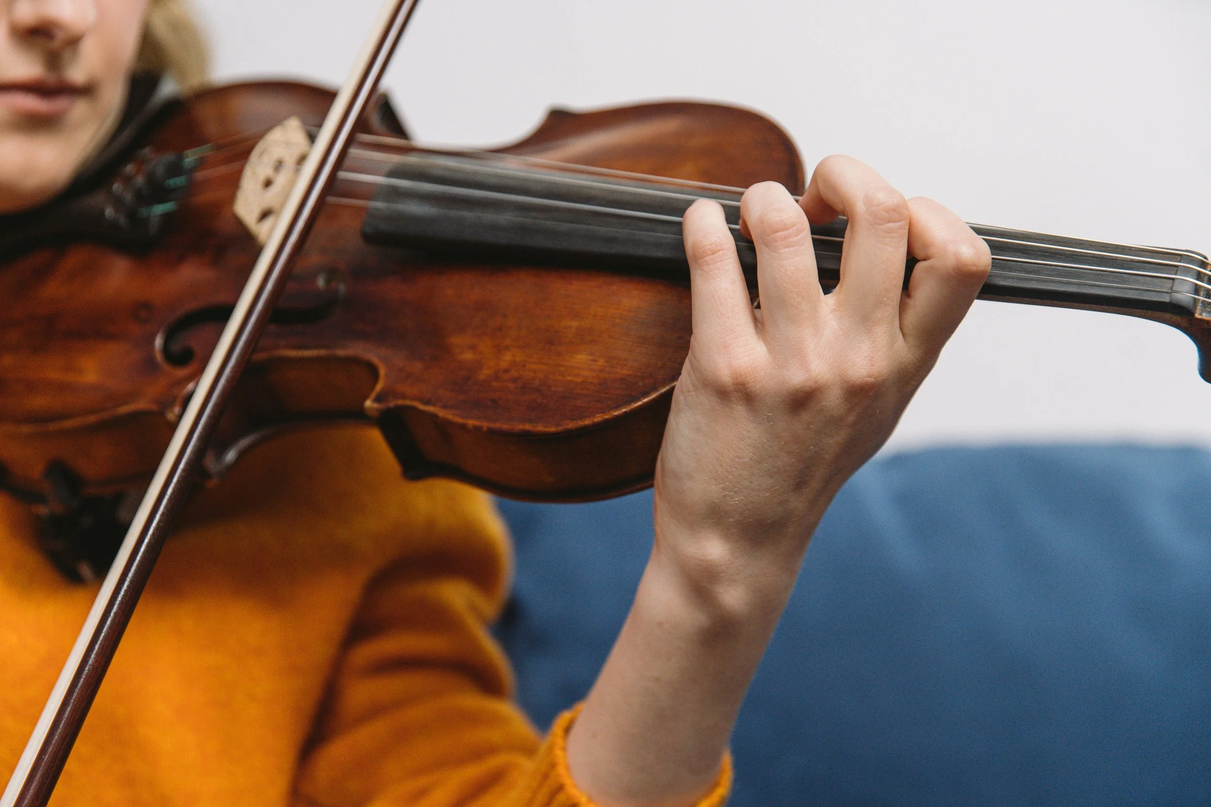
What did you do?
A. Listened to music.
B. Practiced the violin
C. Visited my grandparents

Slide 34
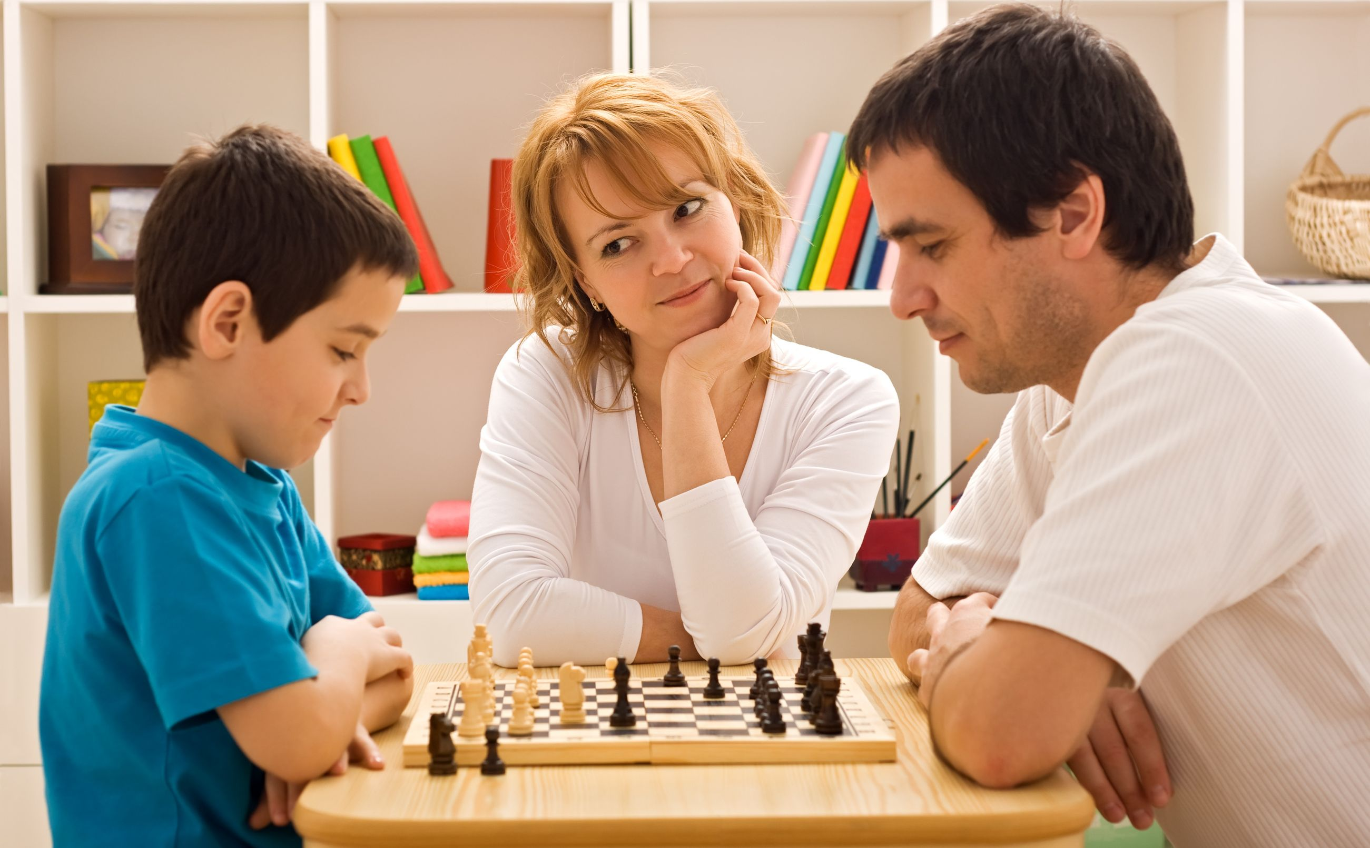
What did they do?
A. Downloaded pictures
B. Watched a baseball game
C. Played a board game

