Slide 1



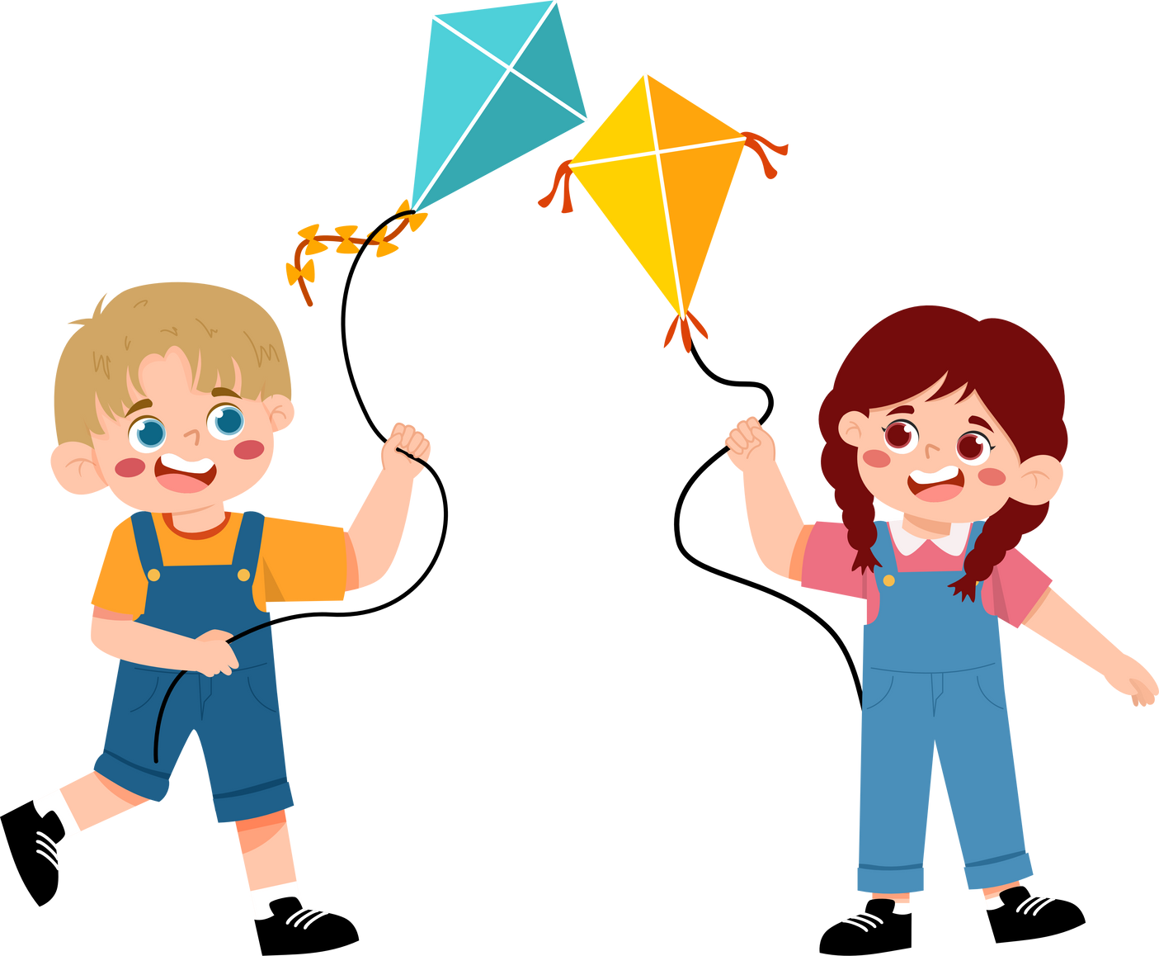
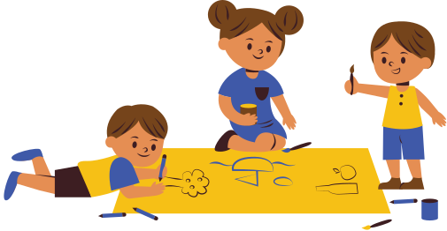
Unit 5
Activities

Slide 2

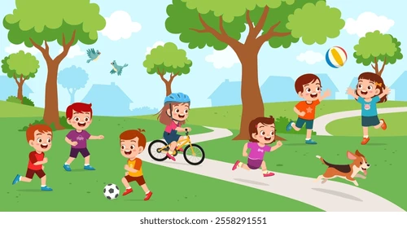
play outside

Slide 3
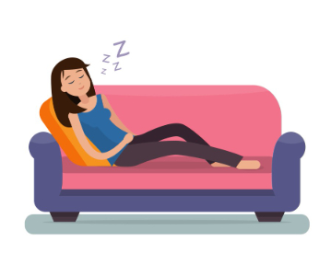
take a nap

Slide 4
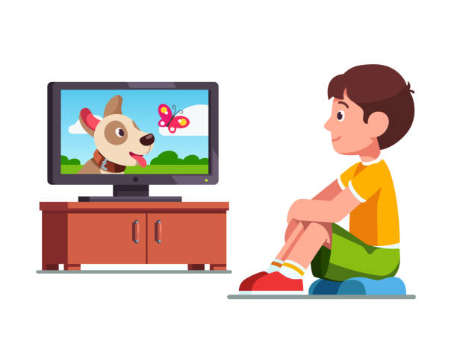
watch TV

Slide 5
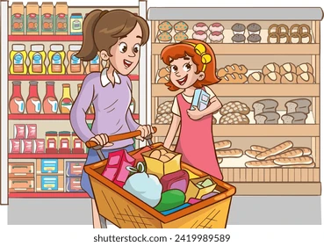
go shopping

Slide 6
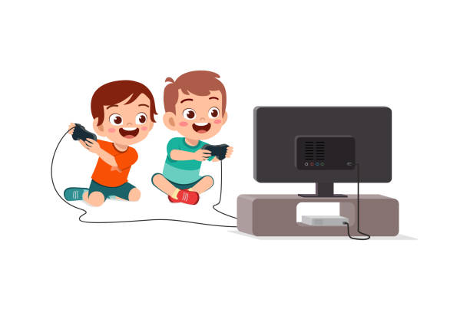
play video games

Slide 7
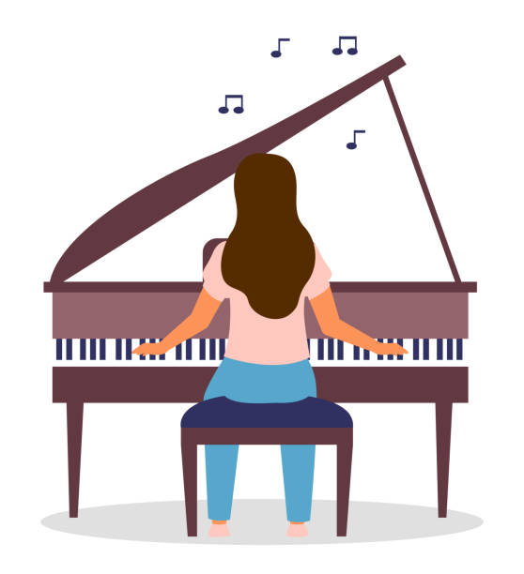
practice the piano

Slide 8
 | Days of the week | Abbreviation
Weekdays | Monday | Mon
Weekdays | Tuesday | Tue
Weekdays | Wednesday | Wed
Weekdays | Thursday | Thu
Weekdays | Friday | Fri
Weekend | Saturday | Sat
Weekend | Sunday | Sun

Slide 9
What does he do on the weekend?
Sun | Mon | Tue | Wed | Thu | Fri | Sat
He plays outside.

Slide 10
What does she do on the weekend?
Sun | Mon | Tue | Wed | Thu | Fri | Sat
She goes shopping.

Slide 11
What do they do on the weekend?
Sun | Mon | Tue | Wed | Thu | Fri | Sat
They play video games.

Slide 12

Does she take a nap on the weekend?
Sun | Mon | Tue | Wed | Thu | Fri | Sat
Yes, she does
No, she doesn’t

Slide 13
Does he watch TV on the weekend?
Sun | Mon | Tue | Wed | Thu | Fri | Sat
Yes, he does
No, he doesn’t

Slide 14
Does she practice the piano on the weekend?
Sun | Mon | Tue | Wed | Thu | Fri | Sat
Yes, he does
No, she doesn’t

Slide 15
Does he watch TV on the weekend?
Sun | Mon | Tue | Wed | Thu | Fri | Sat
Yes, he does
No, he doesn’t

Slide 16


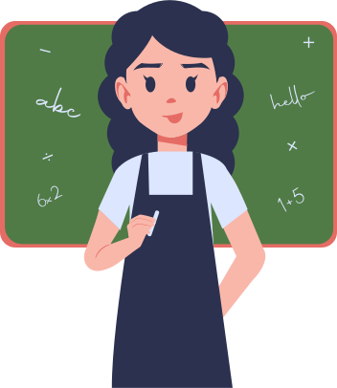
Thank You

